Slide 1
LIBBA 2014 FISHING CONTESTS

Slide 2
THANK YOUS
CAUSEWAY BAIT & TACKLE
Sponsoring the Children’s Division
BOB’S BAIT & TACKLE
Donations to LIBBA
PAULIES BAIT & TACKLE
Donations to LIBBA
WHITE WATER OUTFITTERS
Donations to LIBBA
J & J SPORTS
Donations to LIBBA

Slide 3
LIBBA CONTESTS
KEN KARWICK MEMORIAL CONTEST
Striped Bass, Bluefish & Weakfish
Men’s, Women’s, Youth & Children Divisions
Top 3 fish in each category
Special prizes
Largest released striper
Hidden weight
Exceptional fish
MONTAUK & SOUTH SHORE DERBIES
Striped Bass & Bluefish
Top 3 fish in each category

Slide 4
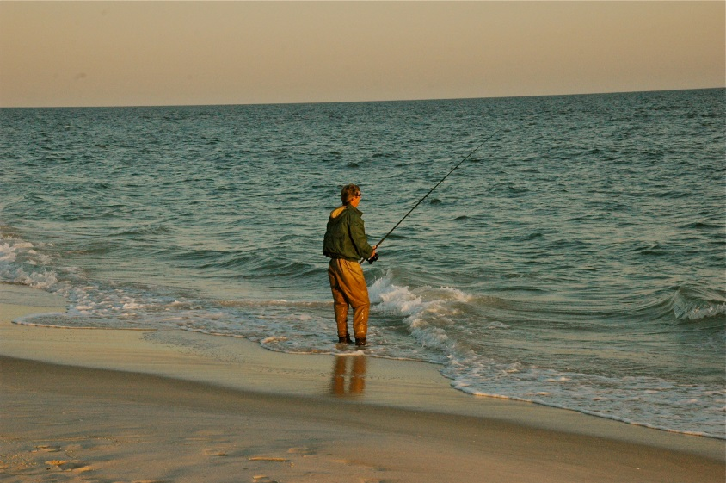
2014 HIGHLIGHTS (AND LOWS)
At times surf fishing was hard
If you were on the beach when the fish came by – you got fish
30 members entered fish
29 striped bass
49 bluefish
4 weakfish
An increase of 18 bass over 2013
1 – 50 #
3 – 40 #
6 – 30 #
A lot more big blues
8 were 16 lb. or bigger
Only 4 weakfish
Montauk Derby
We filled all the slots
South Shore Derby was hard to find bluefish

Slide 5
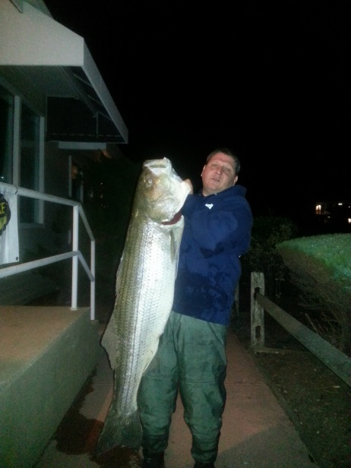
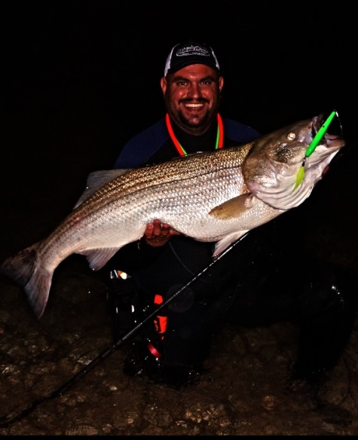
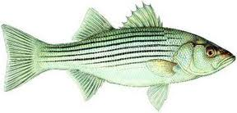
KEN KARWICK CONTEST WINNERS
MEN'S | Mem. # | Wgt
Jason Pecoraro | 2028 | 50.3
Kevin Donahue | 294 | 42.2 T
Vinny Conwell | 2208 | 42 T
Vinny Conwell | 2208 | 41
WOMEN'S
Lorraine Stephens | 1654 | 37.6
Lorraine Stephens | 1654 | 20.2
Barbara Kehlenbeck | 164 | 18.1
YOUTH
Michael Green | 579 | 17.5
CHILDREN'S
None
STRIPED BASS

Slide 6
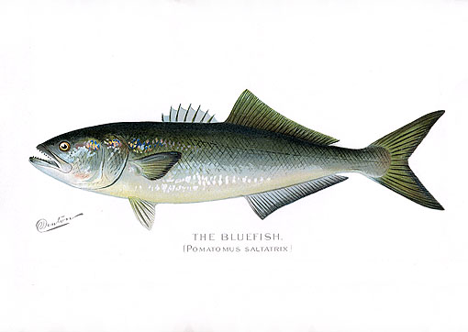
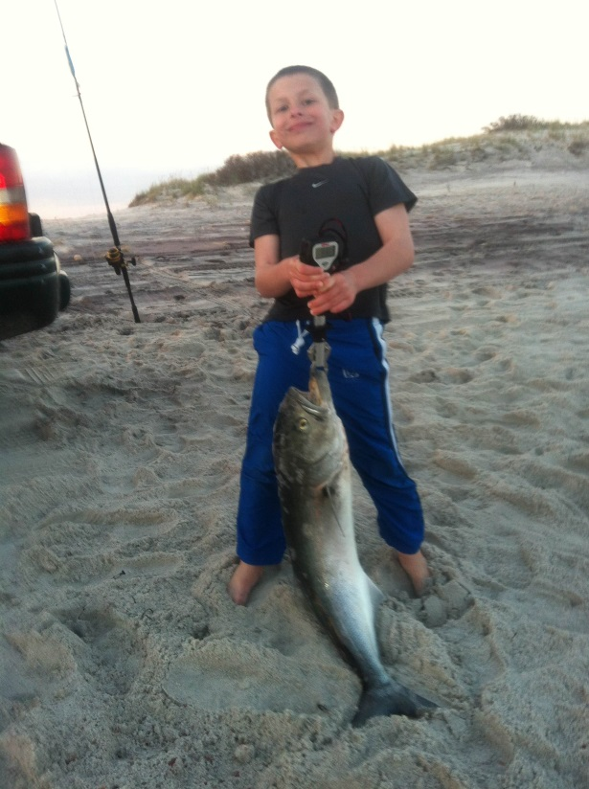
KEN KARWICK CONTEST WINNERS
MEN'S | Mem. # | Wgt
Bruno Panacciulli, Jr | 1494 | 18.75 T
Frank Shortemeyer | 382 | 18.2 T
Leif Gobel | 865 | 18 T
Frank Shortemeyer | 382 | 18 T
WOMEN'S
Ann Shortemeyer | 382 | 16
Barbara Kehlenbeck | 164 | 15.3
Barbara Kehlenbeck | 164 | 14.7
Ann Shortemeyer | 382 | 15
YOUTH
Michael Green | 579 | 11
CHILDREN'S
Dan Gobel | 1937 | 14.5
Dan Gobel | 1937 | 13.5
Jason George | 447 | 12.6
BLUEFISH

Slide 7
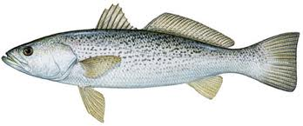
KEN KARWICK CONTEST
WEAKFISH
MEN'S | Mem. # | Wgt
Tom Kehlenbeck | 163 | 7.8
Tom Kehlenbeck | 163 | 6.1
WOMEN'S
Barbara Kehlenbeck | 164 | 6.6
Barbara Kehlenbeck | 164 | 5.7
YOUTH
None
CHILDREN'S
None

Slide 8
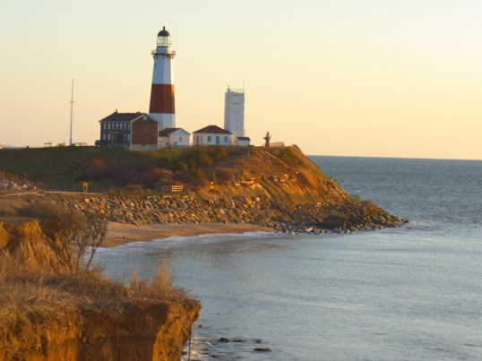
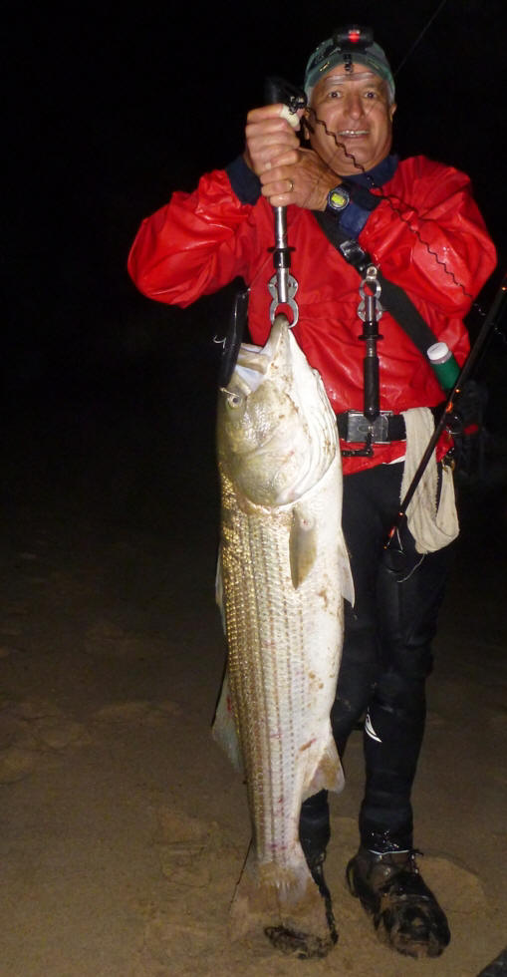
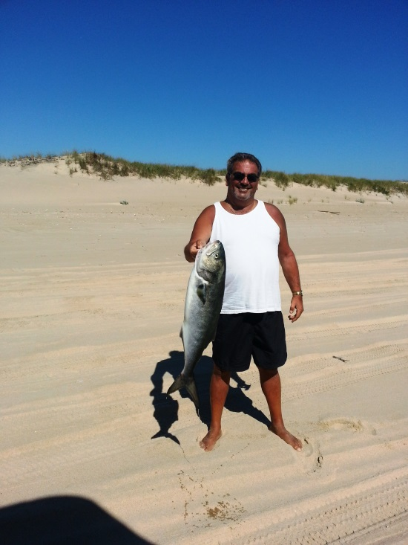
THE DERBIES
MONTAUK DERBY
Striped Bass | Mem # | Wgt
Rick Zappala | 1134 | 30.8
Frank Mecurio | 526 | 23.78
Bill Smith | 457 | 16
Bluefish
Steve Barrale | 681 | 13.4
Andy Richman | 346 | 10.2
Linda Cristiano | 1454 | 9

Slide 9
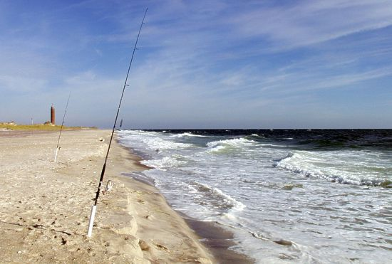
THE DERBIES
SOUTH SHORE DERBY
Striped Bass | Mem # | Wgt
Andy Richman | 346 | 24.9
Lorraine Stephens | 1354 | 20.2
Bruno Panacciulli, Jr | 1494 | 19
Bluefish
Tom Kehlenbeck | 163 | 11.1
Barbara Kehlenbeck | 164 | 10.1

Slide 10
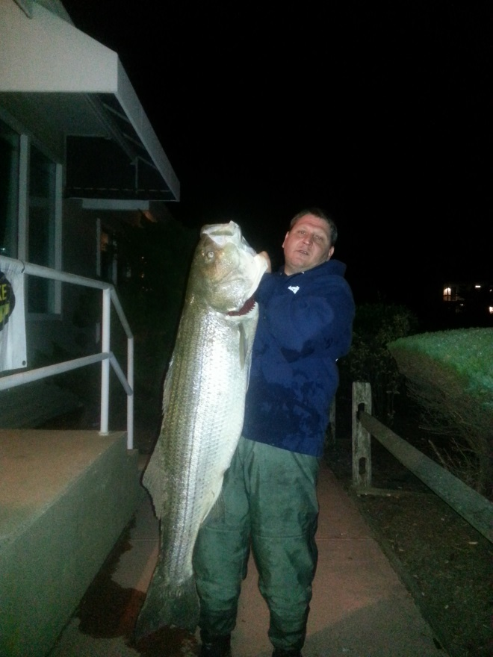
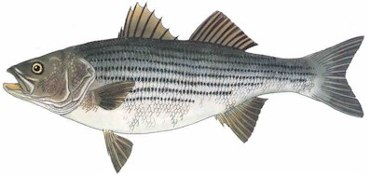
EXCEPTIONAL FISH 2014
Jason Pecoraro 50.3 #

Slide 11
LARGEST RELEASED STRIPED BASS
Andy Richman 39”

Slide 12
HIDDEN WEIGHT
All those who entered fish that DID NOT place in the contests are eligible
Now to pick the winning name
BILL DAVISON

Slide 13
REMEMBER TO ENTER YOUR FISH IN 2015!!!!!
Weigh slips are on the website
Contest runs April 15 to Dec 15
All slips must be postmarked by Dec 31
We would love to see more members enter their fish!!

